Slide 1


E-TALKING BEST FOR YOU
E-TALKING BEST FOR YOU
Getting to a place
Talking about transport.
view
Image from : unsplash.com

Slide 2

E-TALKING BEST FOR YOU
E-TALKING BEST FOR YOU
INTRODUCTION
CEF Learning Goal: Learning how to express quantity.

Slide 3
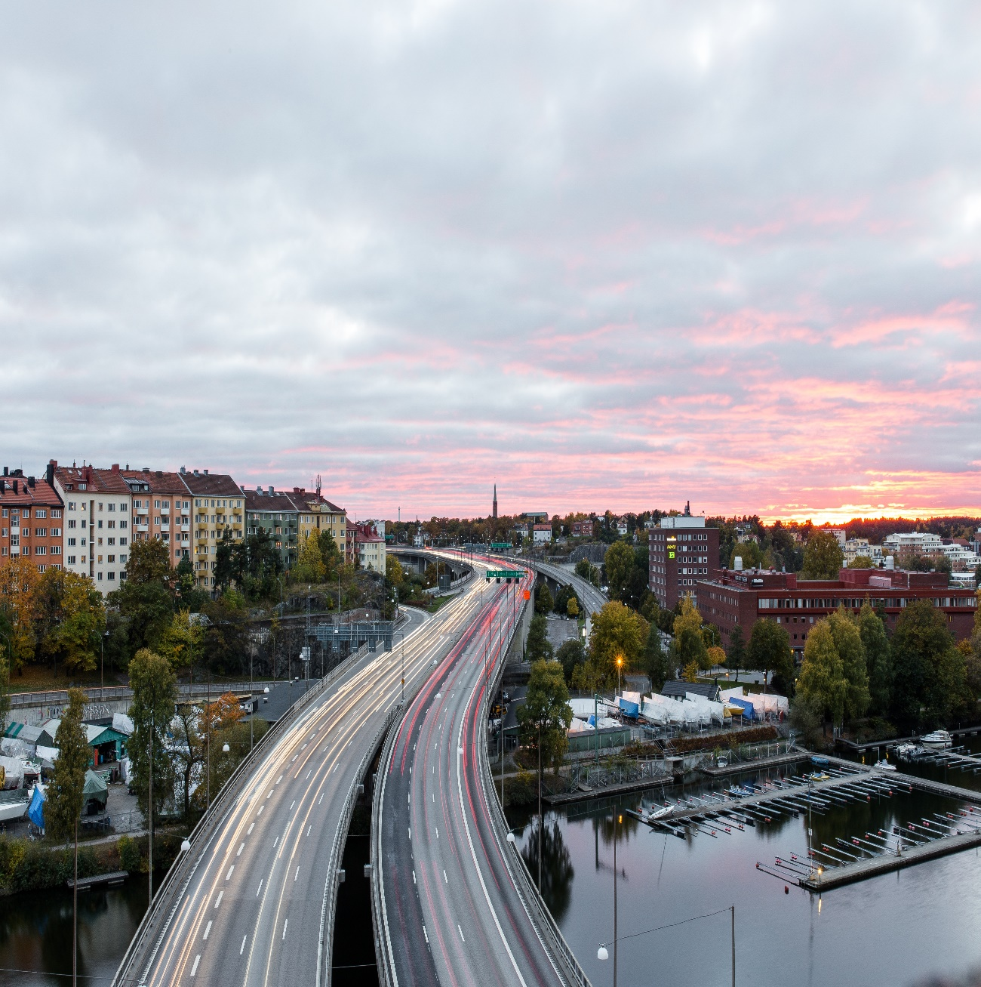
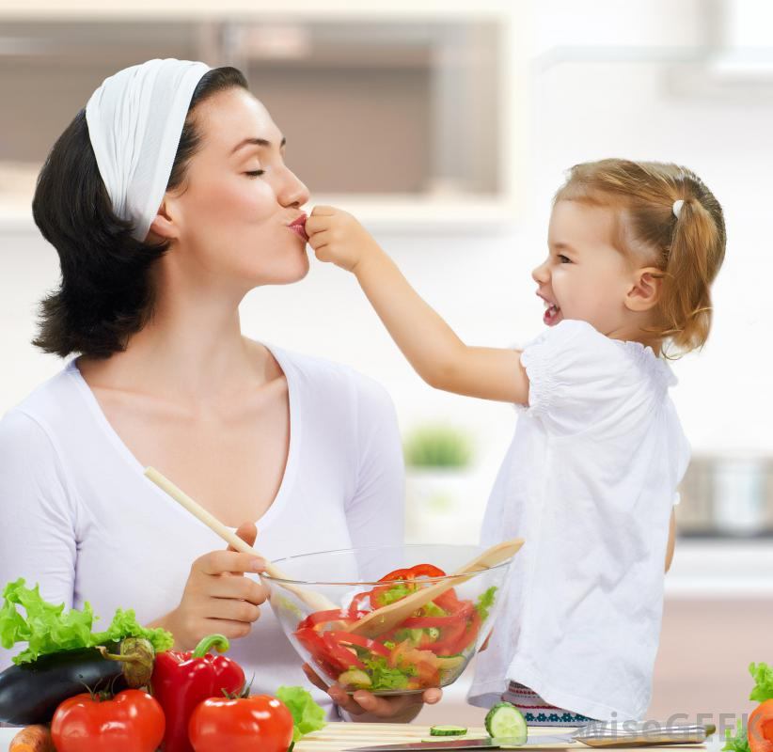
E-TALKING BEST FOR YOU
E-TALKING BEST FOR YOU
How can we travel around? We may go to places by using many kinds of transportation. In this lesson, you will learn about the different means of transportation you may use.
START
Image from : unsplash.com

Slide 4

E-TALKING BEST FOR YOU
E-TALKING BEST FOR YOU
WARM-UP
How do you go to work?
Is there a train from here to Sydney?

Slide 5

E-TALKING BEST FOR YOU
E-TALKING BEST FOR YOU
GETTING STARTED
How do you go to school/work?
Have you ever been on an airplane?

Slide 6
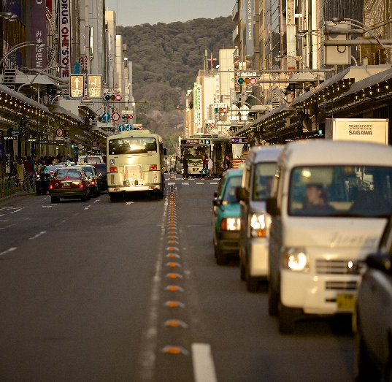
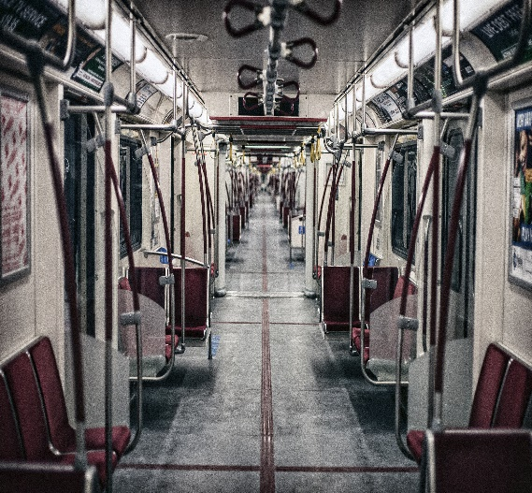
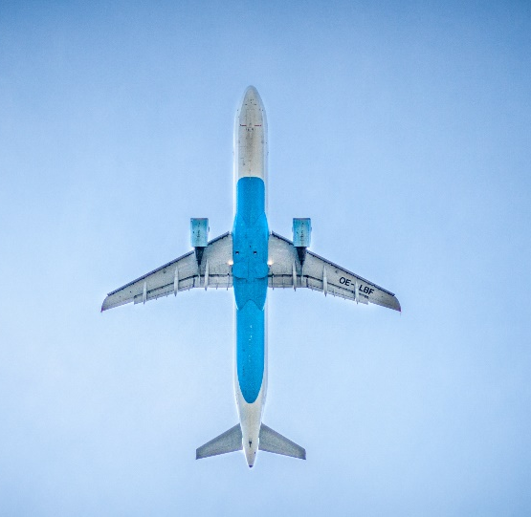
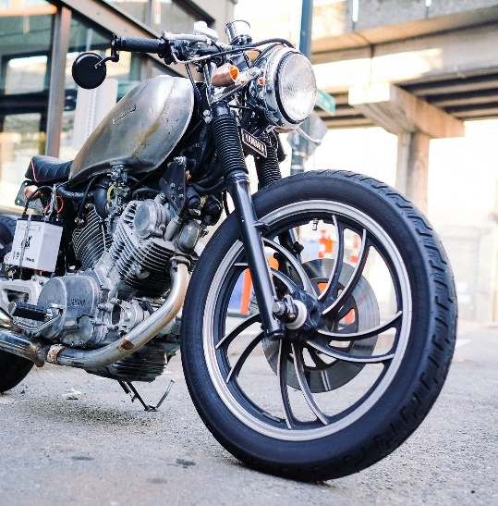
E-TALKING BEST FOR YOU
01 Transport
E-TALKING BEST FOR YOU
When we want to get to a place, we might need transportation. Here are some common transportation methods that we might need when we travel:
Bus
Train
Taxi
Subway
Airplane
Bicycle
Car
Motorcycle
Image from : unsplash.com
Image from : unsplash.com
Image from : unsplash.com
Image from : unsplash.com

Slide 7
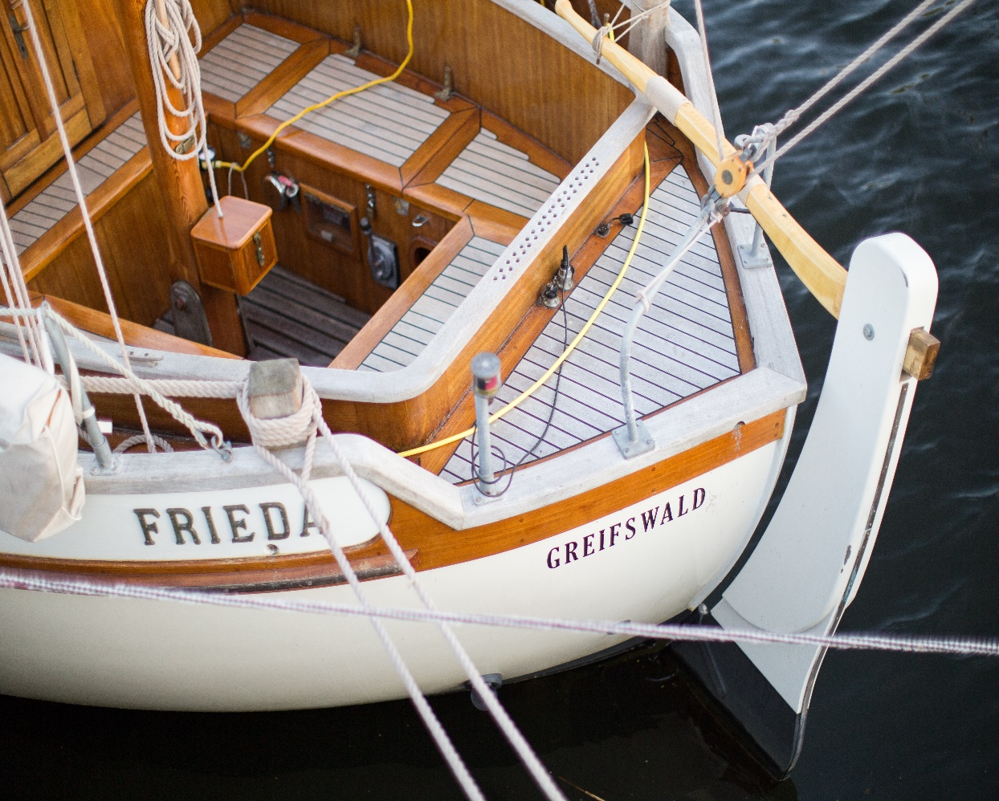
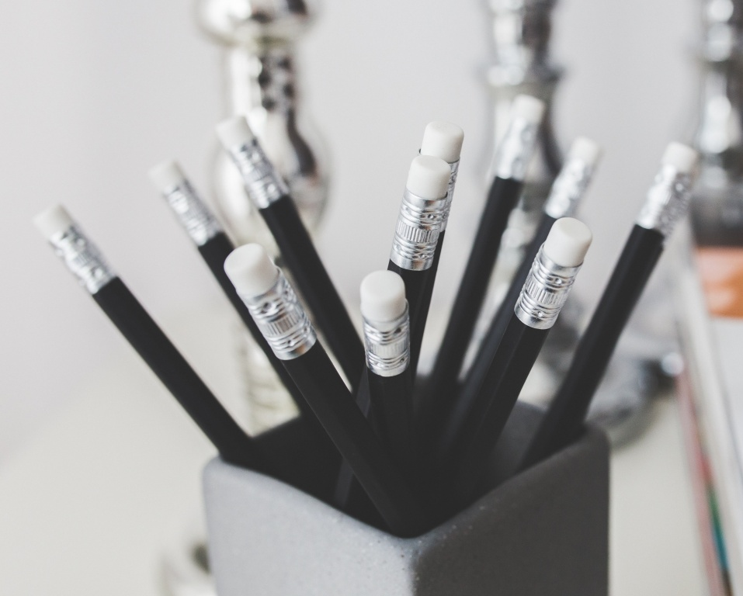
E-TALKING BEST FOR YOU
01 Transport
E-TALKING BEST FOR YOU
Practice:
Which is your favorite means of transportation? Why?
Image from : http://www.sfgate.com/education/article/Cuts-in-programs-to-help-inmates-questioned-3199585.php#photo-2338768

Slide 8
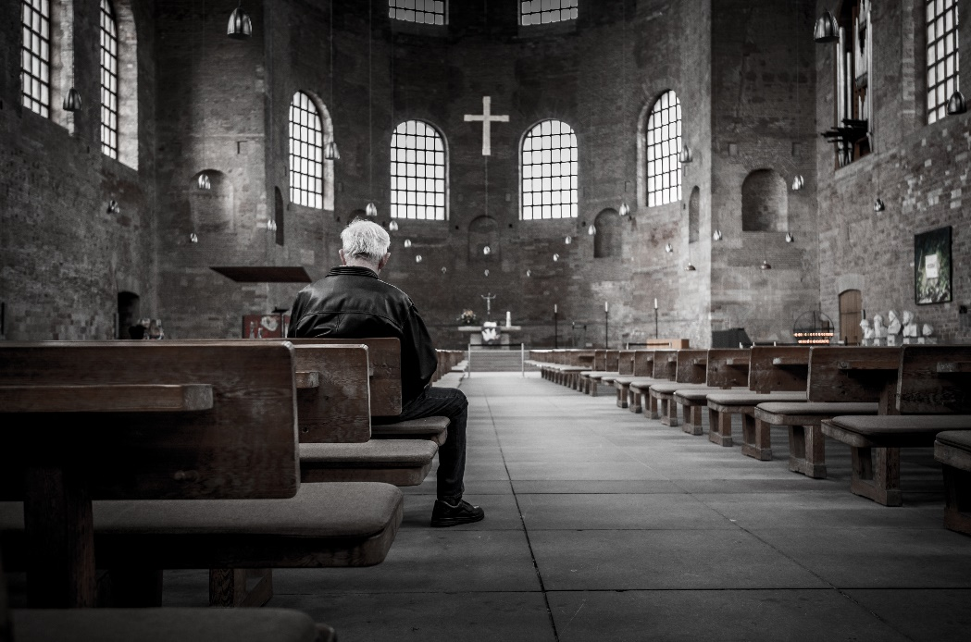


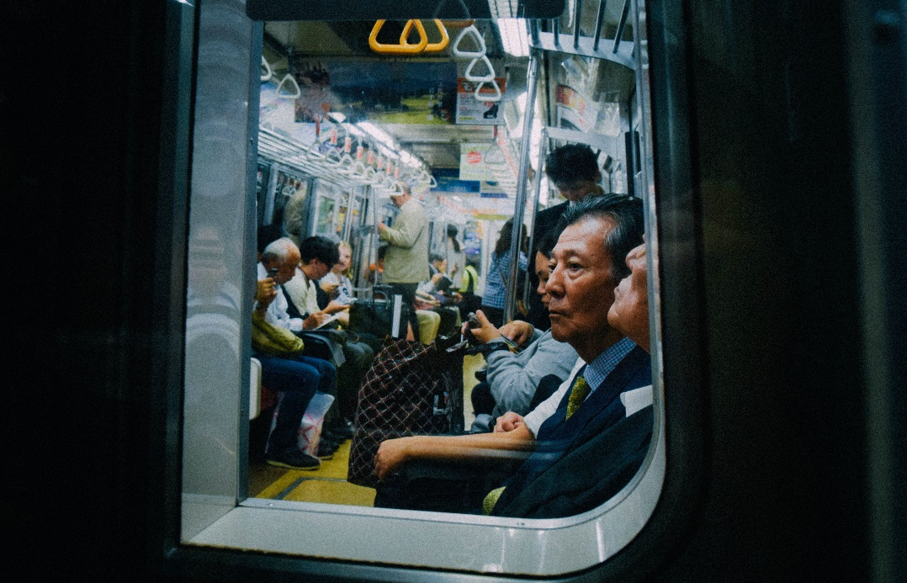
E-TALKING BEST FOR YOU
02 How do you go to class?
E-TALKING BEST FOR YOU
When you want to ask someone which means of transportation they use to get somewhere, you can use the following questions:
How do you go to the supermarket?
What's your favorite meansof transportation to go to work?
Image from : unsplash.com
Image from : unsplash.com

Slide 9
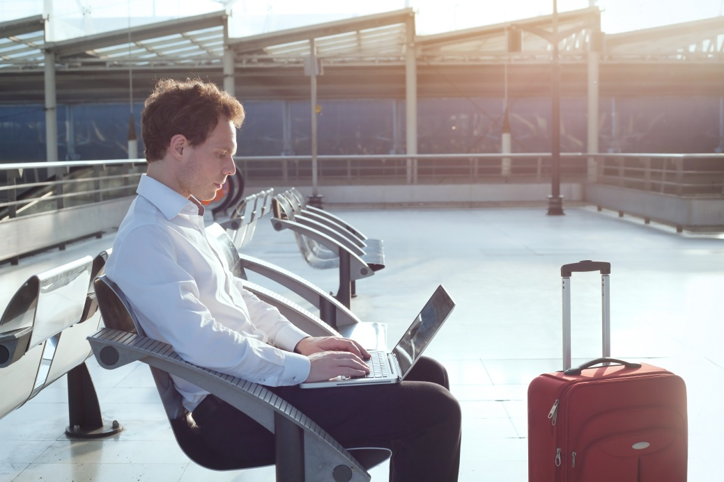
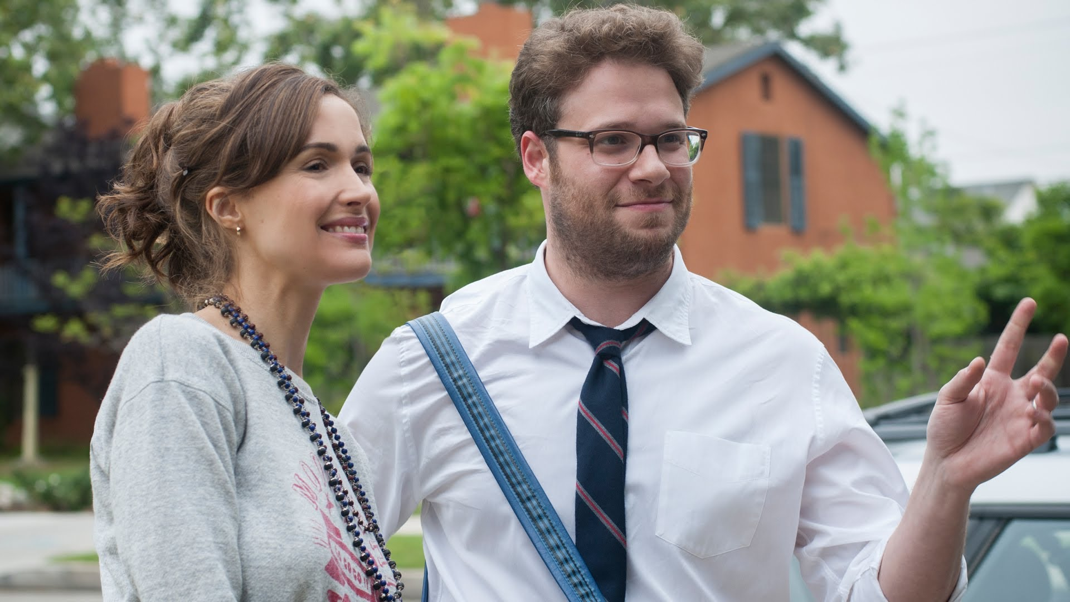
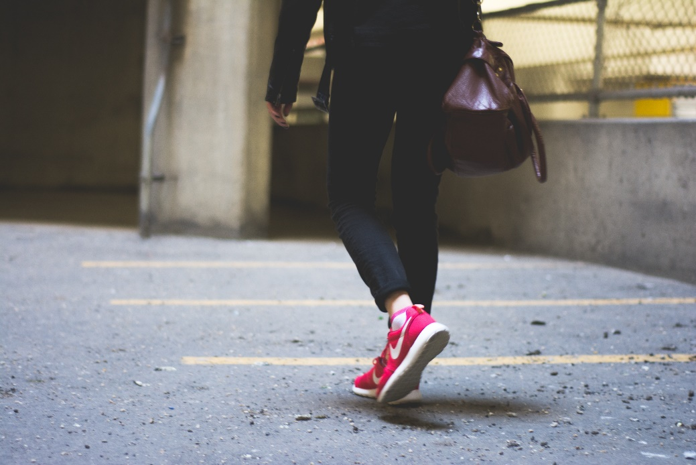
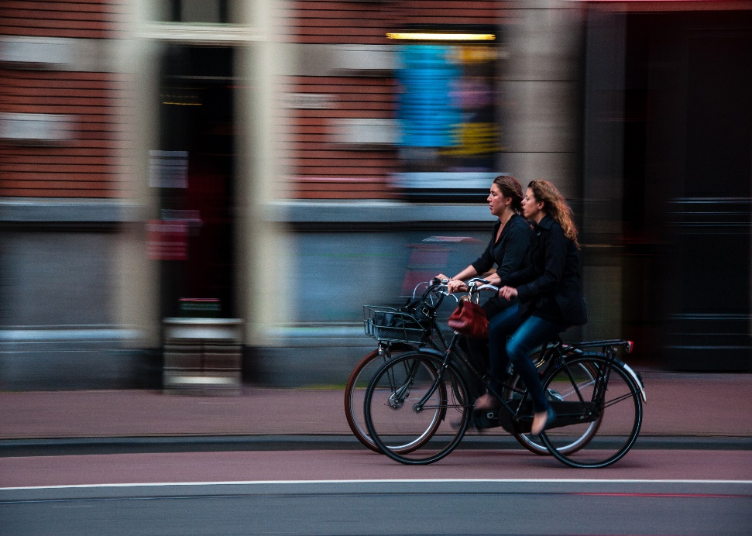
E-TALKING BEST FOR YOU
02 How do you go to class?
E-TALKING BEST FOR YOU
And when you are the one to answer the question, you can say:
I go to the supermarket by walk.
I go to work by car.
I usually ride a bike to school.
I like to ride a motorcycle to the bank.
Image from : https://www.theodysseyonline.com/12-ways-christmas-spirit
Image from : chui-kun.com.tw
Image from : https://www.youtube.com/watch?v=pzZgJZMXNEc

Slide 10
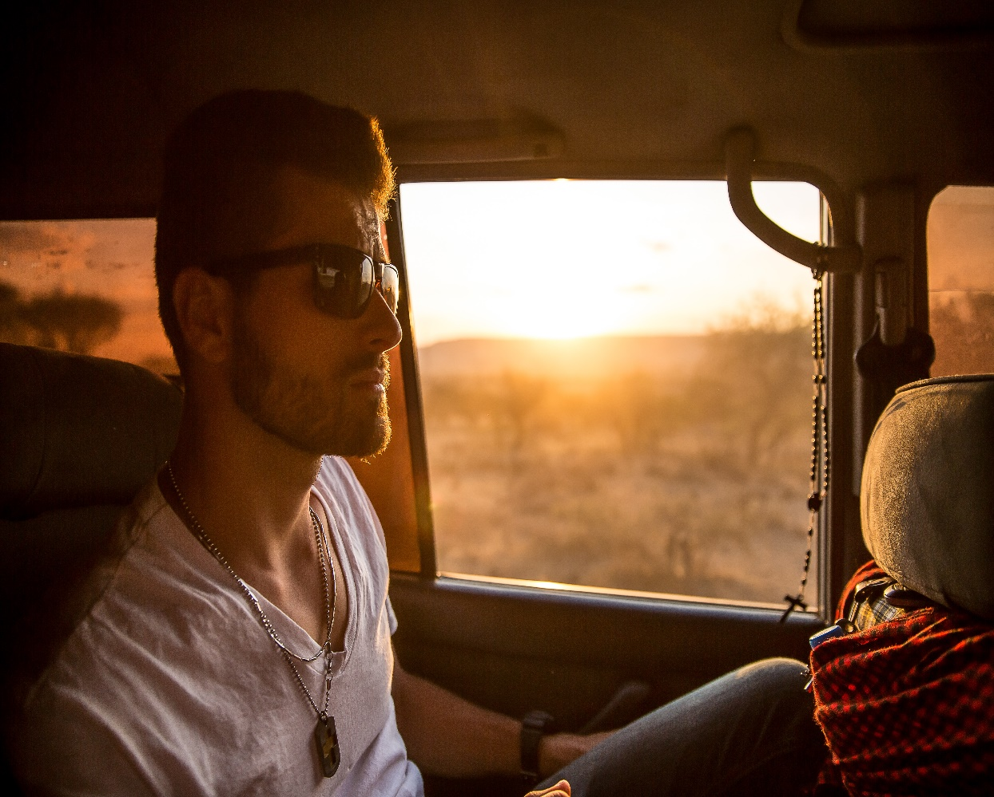
E-TALKING BEST FOR YOU
02 How do you go to class?
E-TALKING BEST FOR YOU
Practice:
Team up with a partner. Ask them how they go places, and take turns to answer.
Image from : http://www.sfgate.com/education/article/Cuts-in-programs-to-help-inmates-questioned-3199585.php#photo-2338768

Slide 11
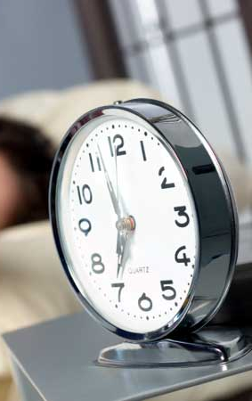
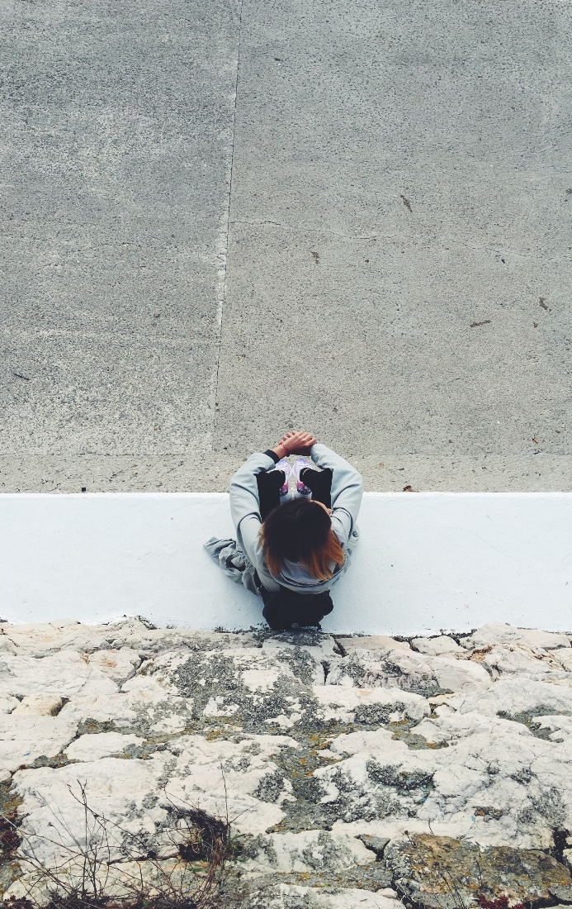
E-TALKING BEST FOR YOU
E-TALKING BEST FOR YOU
03 Reading: transports around the world
There are 3 million cars in Moscow and 22 pink taxis. The pink taxis are special because they are for women, and the drivers are women too. About five million people go places by subway or underground every day in New York City. In China, people often sit on the front seat of taxis, because they believe it is respectful for the driver.
Image from : unsplash.com

Slide 12
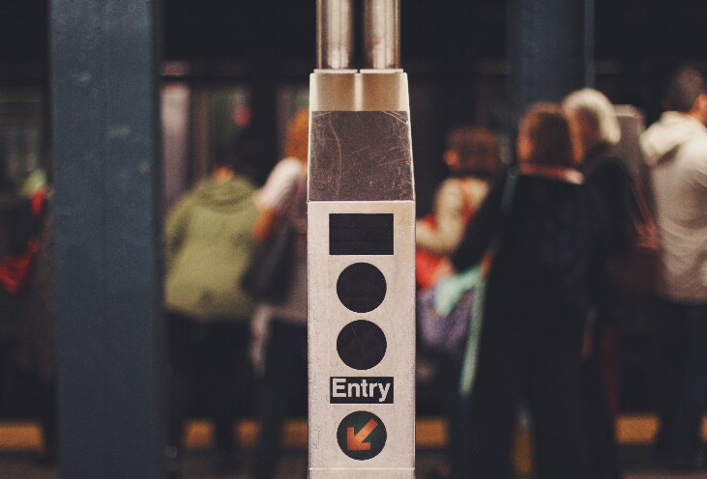
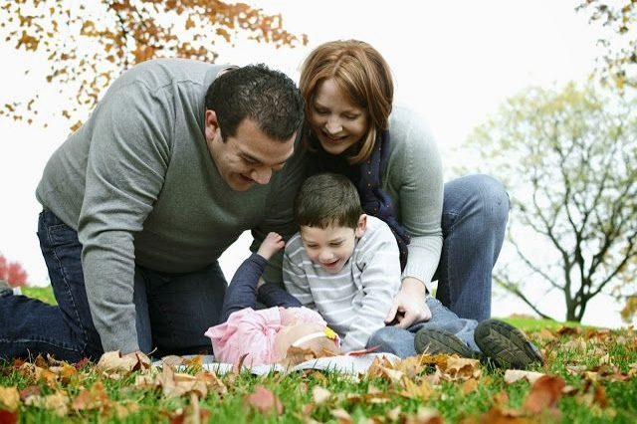
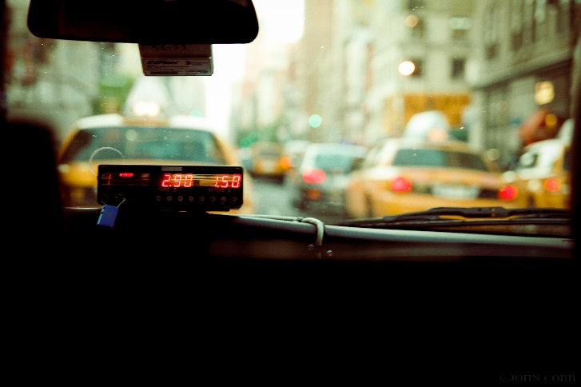

E-TALKING BEST FOR YOU
E-TALKING BEST FOR YOU
03 Reading: transport around the world
Practice
In which city are there five million people using the subway each day?
Why do people in China sit in the front seat of taxis?
Image from: unsplash.com

Slide 13
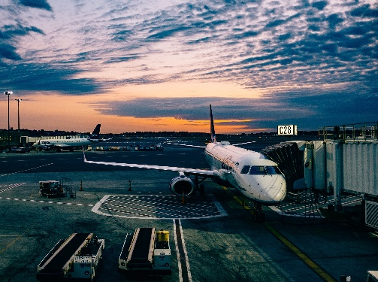

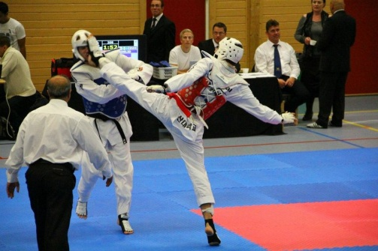
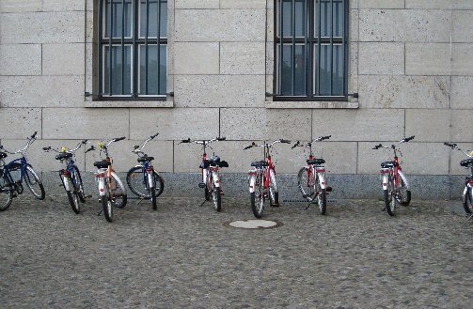
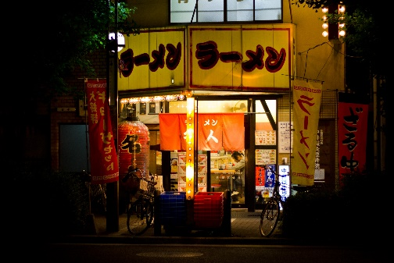
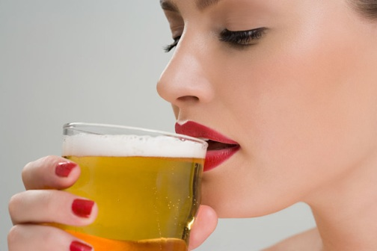
E-TALKING BEST FOR YOU
04 a/an, some, a lot of, not any
E-TALKING BEST FOR YOU
Practice
There is an airport in Taipei City.
There are some bus stops in this area.
There are a lot of bicycles in this place.
There isn’t any railroad here.
There aren’t any restaurants in the neighborhood.
Image from: unsplash.com

Slide 14
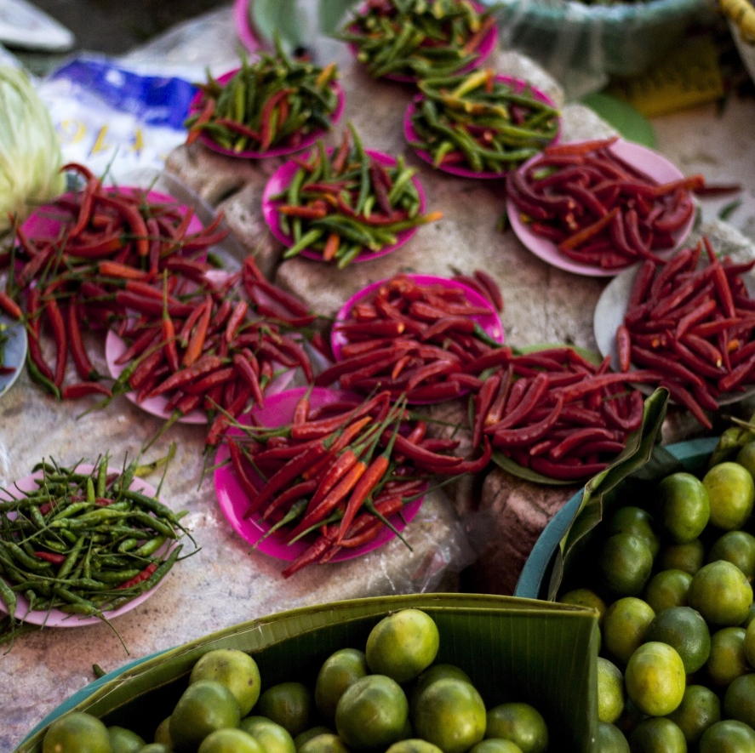

E-TALKING BEST FOR YOU
E-TALKING BEST FOR YOU
04 a/an, some, a lot of, not any
Practice:
Choose the right answer:
There is a/an market around here.
There are any/some taxis in front of the bus stop.
Image from : unsplash.com

Slide 15

E-TALKING BEST FOR YOU
E-TALKING BEST FOR YOU
SPEAKING TASK
Which place do you want to visit the most?
What means of transportation do you think you can use during your trip?

Slide 16

E-TALKING BEST FOR YOU
E-TALKING BEST FOR YOU
ASSESSMENT
Choose the right answer:

Slide 17

E-TALKING BEST FOR YOU
E-TALKING BEST FOR YOU
There aren’t/isn’t any taxis on the street.
There are any/some motorbikes on the road.
Is/Are there an airport?
There are some/any places to visit.
There is a/an bus stop.
ASSESSMENT

Slide 18


E-TALKING BEST FOR YOU
E-TALKING BEST FOR YOU
Thank you !
See you tomorrow

